Slide 1
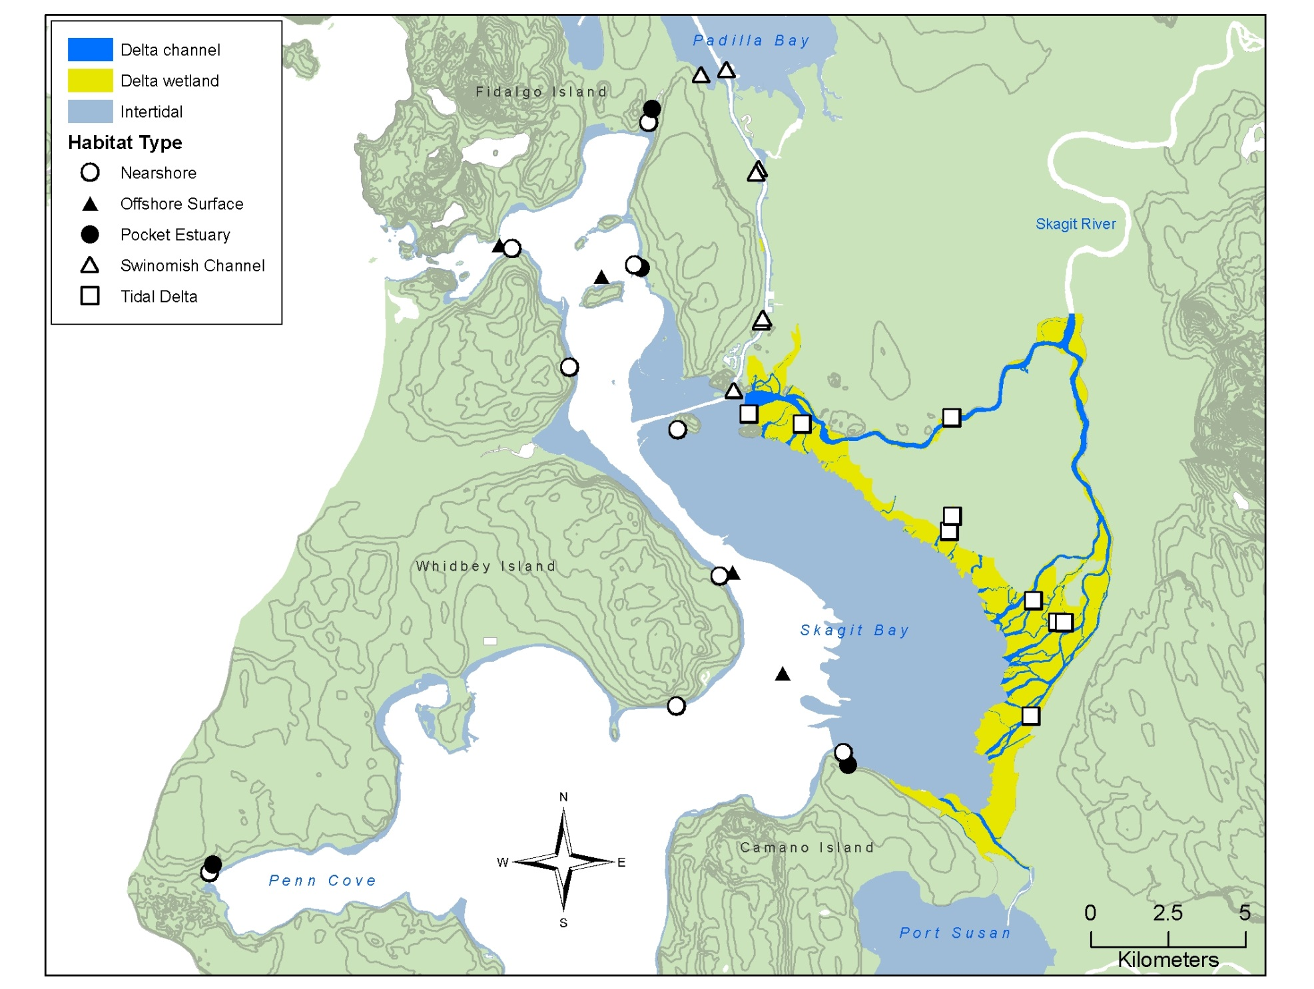
Skagit Index Sites
Turner’s Spit
Hoypus Pt
Lone Tree Pt
Dugwalla
Grain of
Sand
Cattail
Ika
Goat I
Fir Island Farms
Brown’s Slough
(Boat
ramp)
Strawberry Pt
Freshwater Pond
Deepwater
Mariner’s Bluff
Brown Pt
Tom Moore

